Slide 1
Travel Ticket Boking
Done by :
Your name
Guidance of :
Your teacher name

Slide 2
CONTENTS
INTRODUCTION
PROBLEM
STATEMENT
DATA FLOW DIAGRAM
MODULE OF PROJECTS
PROJECT SCREENSHOTS
FUTURE SCOPE
CONCLUSION
REFERENCE

Slide 3
INTRODUCTION
The Sum of the phenomena and relationship arising from the travel and stay of non residents.
Travel management system provide reservation facility to there customer.
Maximize travel policy compliance all areas including best fares, allowances and approval.

Slide 4
PROBLEM STATEMENT
The purpose of website is established fact that Internet users are increasing today. Today One of the main purposes of the website is to facilitate the offline customer online because customers cannot spend their precious time in markets trying to find out the best deal. Travel management system provide reservation facility to there customer. Maximize travel policy compliance all areas including best fares, allowances and approval.
Our priority will be our customers and their travel requirements. There will be many users visiting the portal and hence we require a strong and reliable frontend which can withhold the users on our site.
We will be putting an effort to provide the right choice to the people when they plan a holiday and beware them from the false advertising

Slide 5
DATA FLOW DIGRAM
Home
Gallery
Packages
Services
Review
Contact
Login
Book
Sign up
Send OTP

Slide 6
MODULES OF PROJECT
CUSTOMER
Login or Sign up
Booking
Gallery
Feed back

Slide 7
MODULES OF PROJECT
ADMIN
Login (as admin super-user)
See Users
Manage Tour and Booking
View feedback

Slide 8
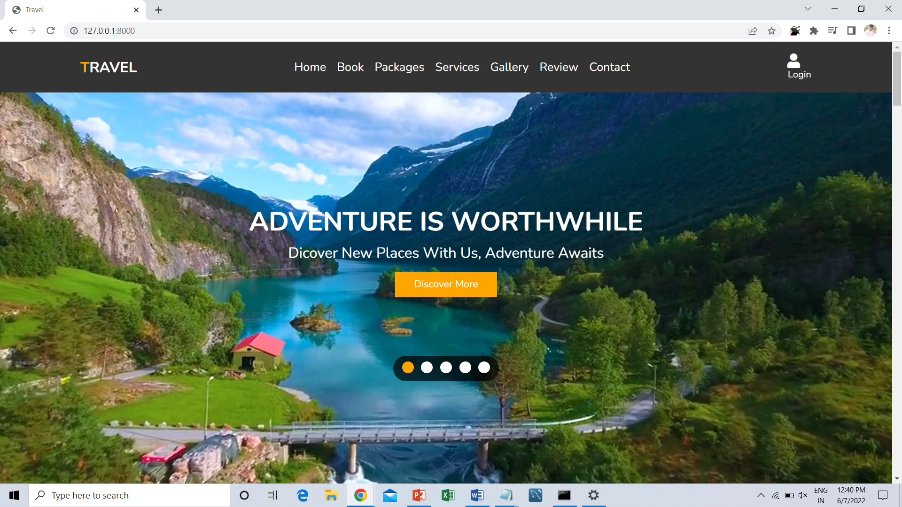
PROJECT SCREENSHOTS
Home page

Slide 9
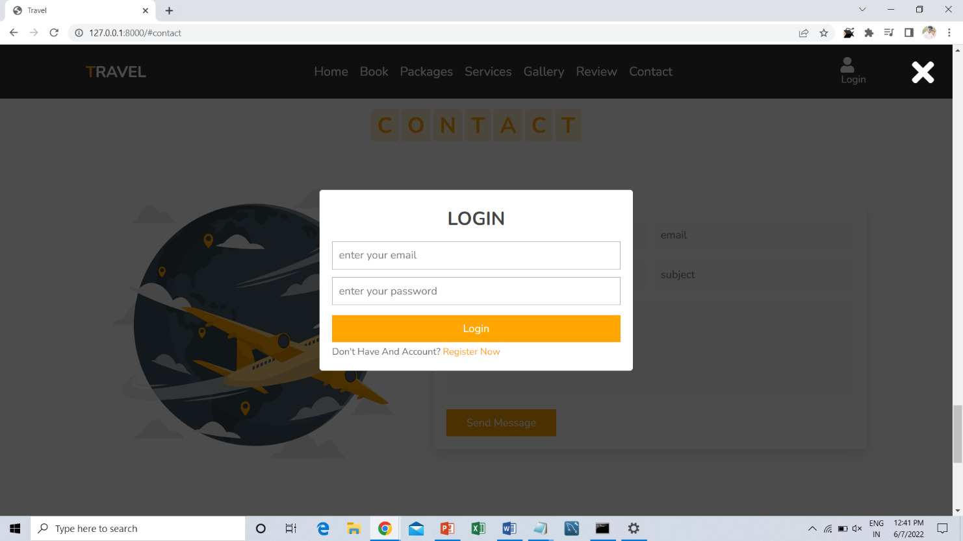
PROJECT SCREENSHOTS
Login Page

Slide 10
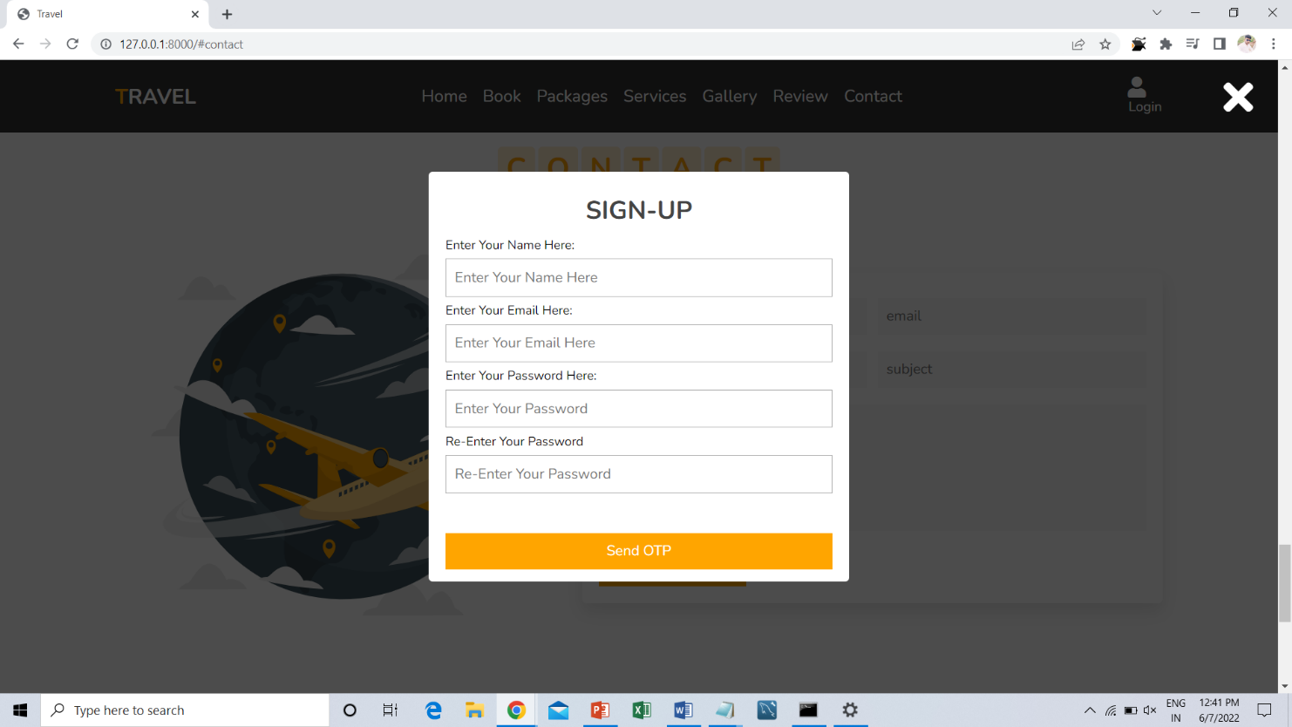
PROJECT SCREENSHOTS
Sign-Up Page

Slide 11
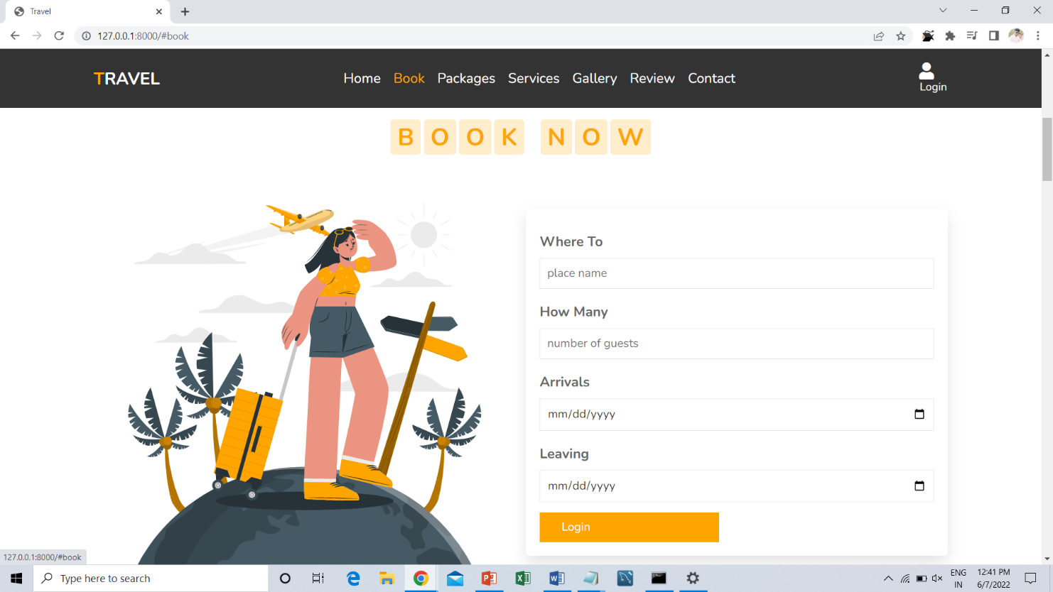
PROJECT SCREENSHOTS
Book Page

Slide 12
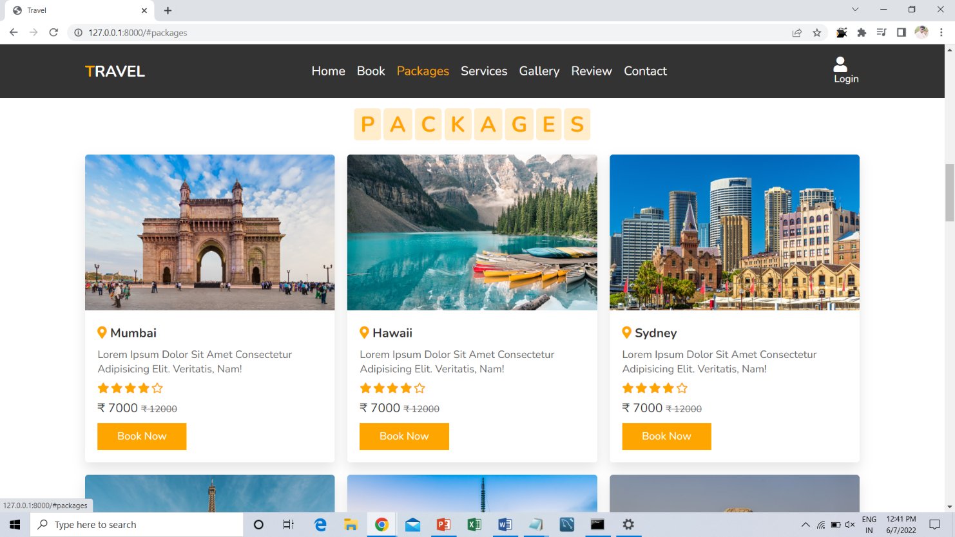
PROJECT SCREENSHOTS
Packages Page

Slide 13
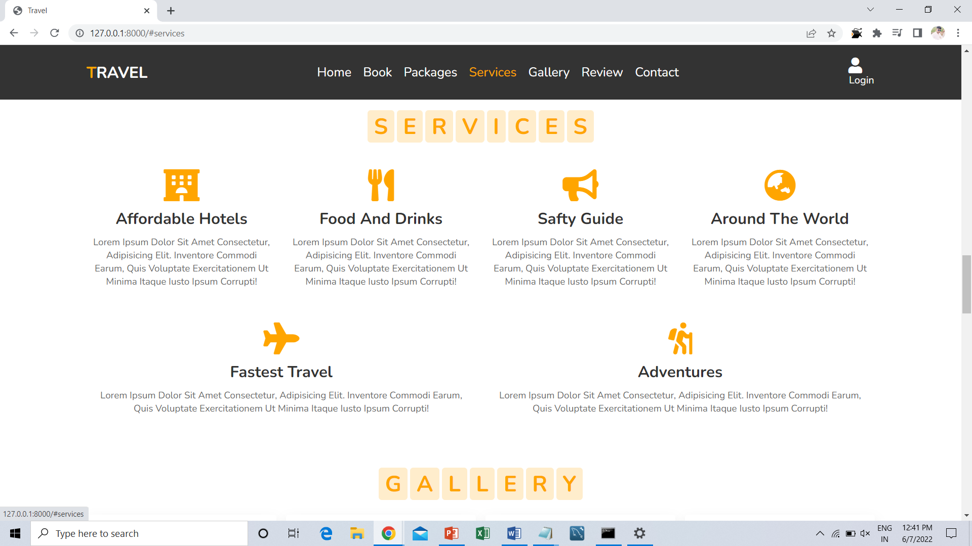
PROJECT SCREENSHOTS
Services Page

Slide 14
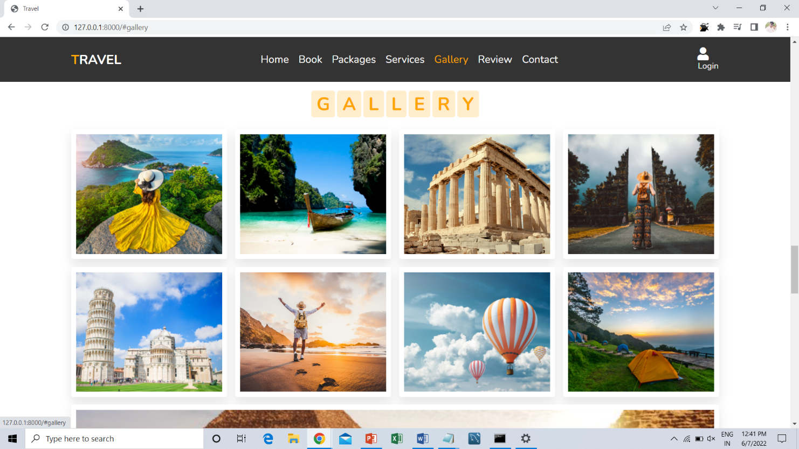
PROJECT SCREENSHOTS
Gallery Page

Slide 15
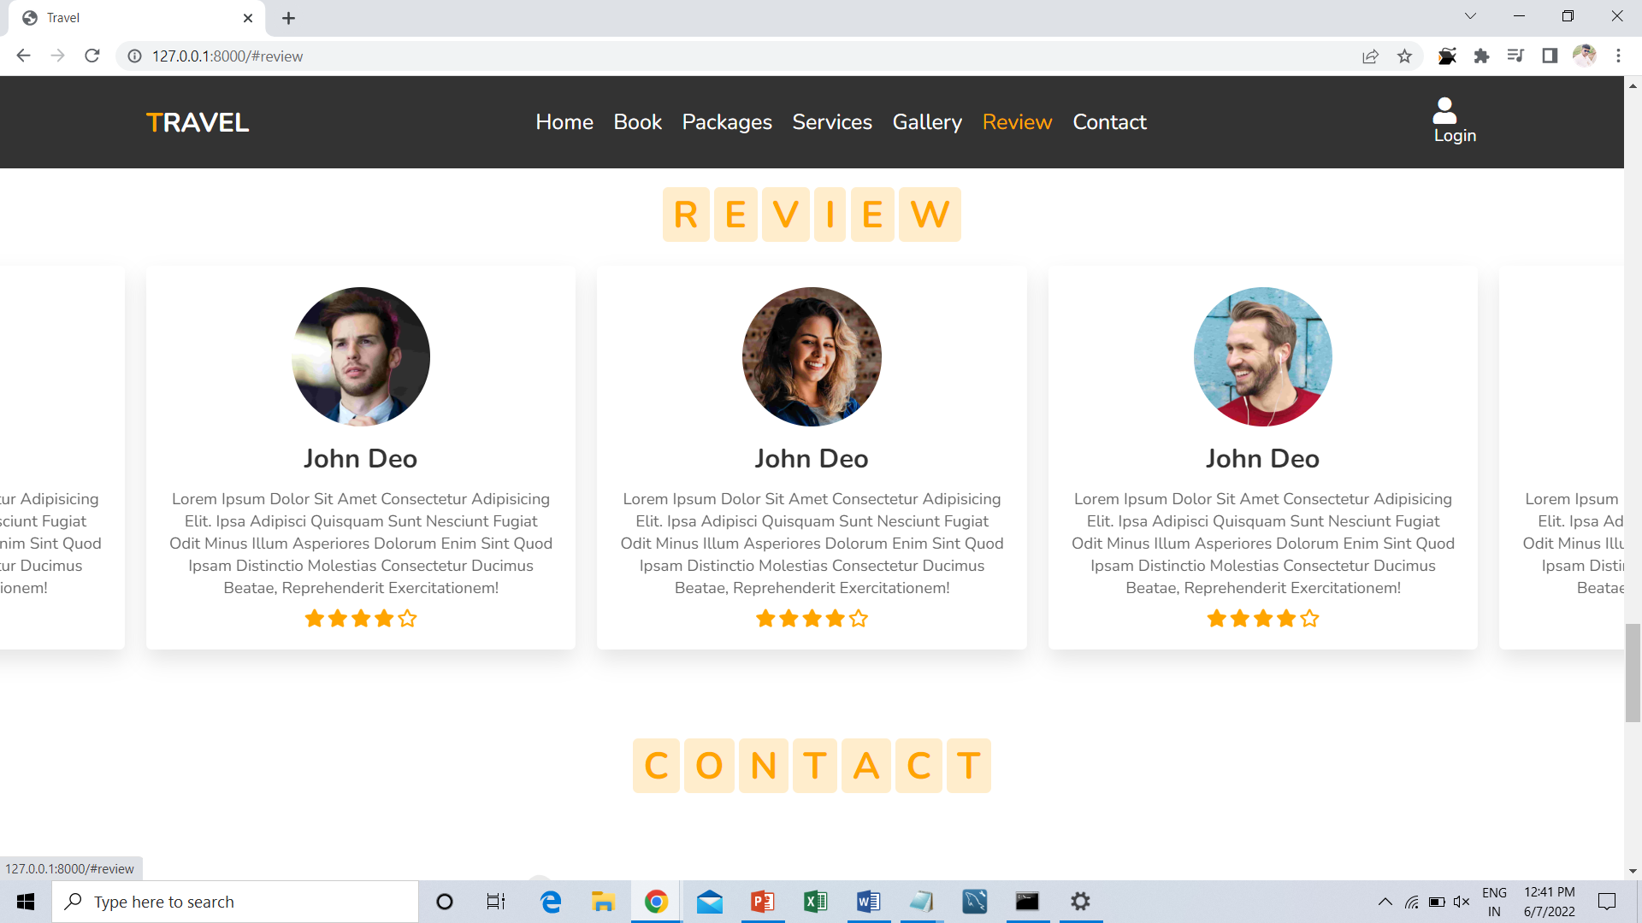
PROJECT SCREENSHOTS
Review Page

Slide 16
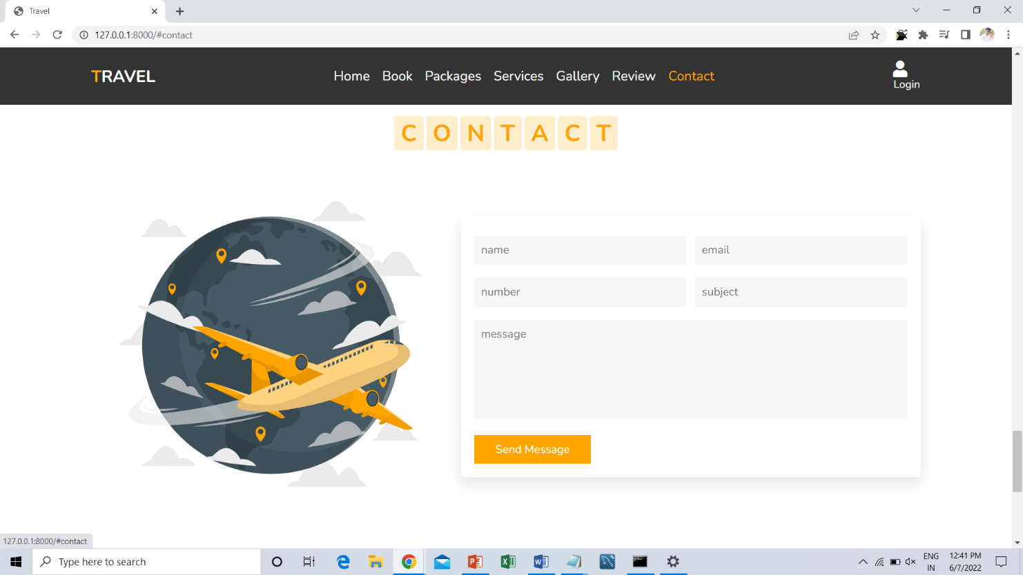
PROJECT SCREENSHOTS
Contact Page (feedback)

Slide 17
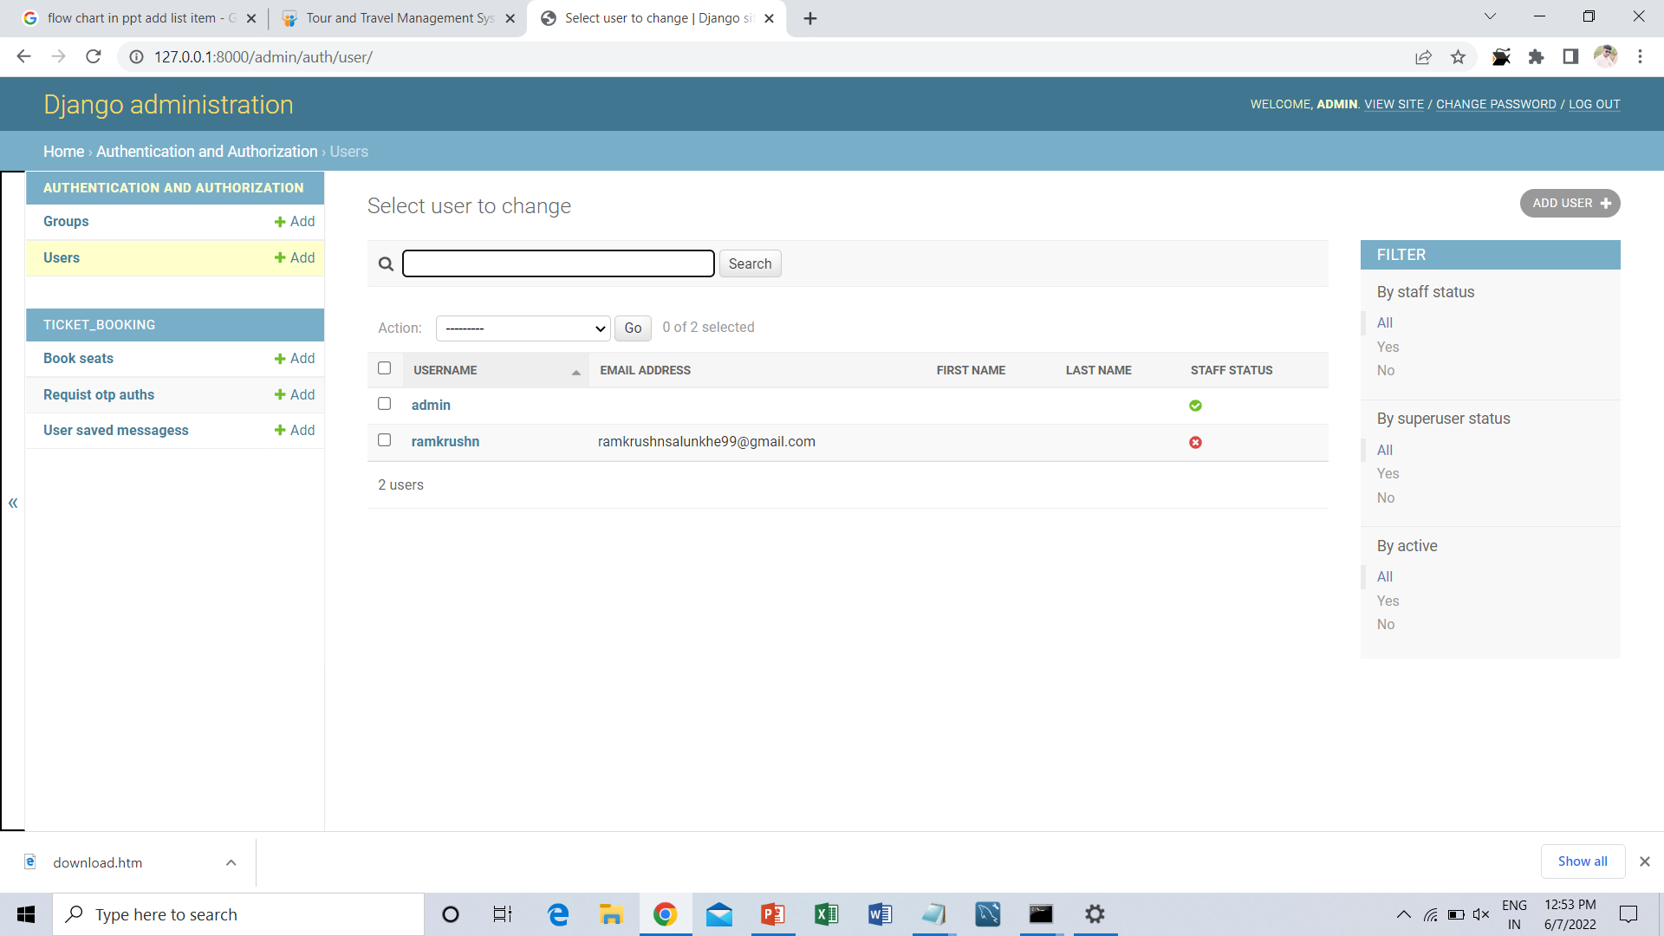
PROJECT SCREENSHOTS
Admin See Users

Slide 18
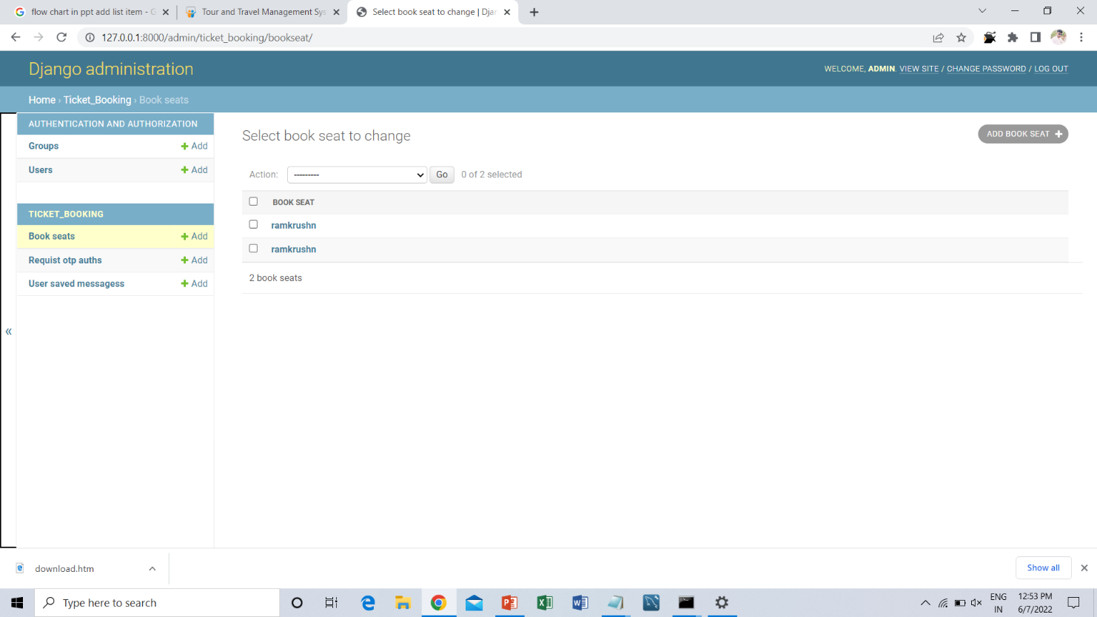
PROJECT SCREENSHOTS
Admin See Bookings

Slide 19
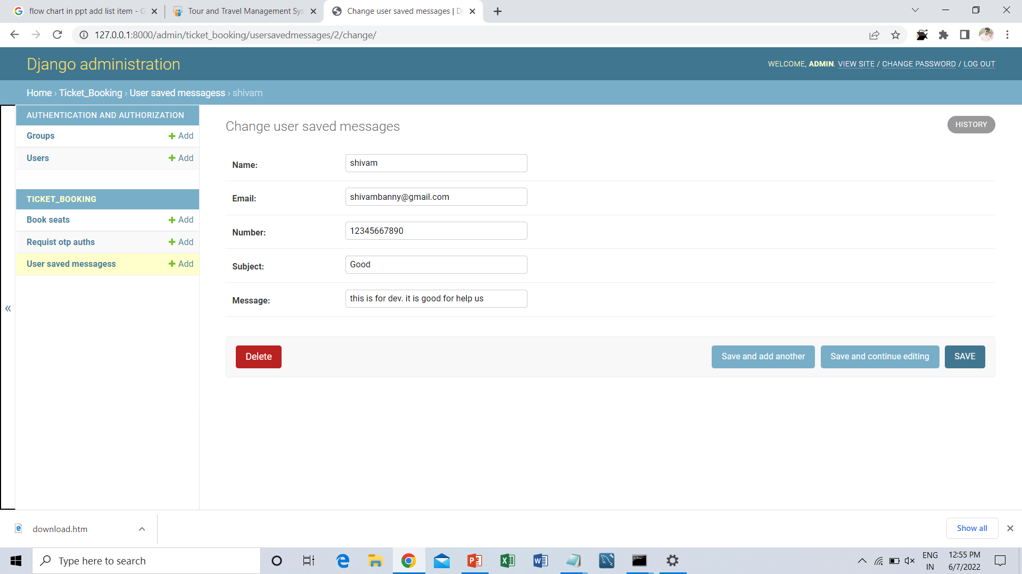
PROJECT SCREENSHOTS
Admin See Feedbacks

Slide 20
FUTURE SCOPE
We will include more functionality as per the user requirements.
We want to improved our home page, as it is the main thing which attracts all user
Not a single website is ever consider as complete forever firstly because there is always something new requirement also are growing day by day.

